Slide 1


DR.MGR EDUCATIONAL AND RESEARCH INSTITUTE
MORTALITY PREDICTION OF SEPSIS
Presented By
T.NAGA SIRISHA-211211101328
V.SRI VARSHA-211211101339

Slide 2


CONTENTS
Abstract
Introduction
Background and Motivation
Methodology
Existing System
Proposed System
Implementation
Test Cases
Result
Conclusion
References

Slide 3

ABSTRACT
Sepsis is an important cause of mortality, especially in intensive care unit (ICU) patients. Developing novel methods to identify early mortality is critical for improving survival outcomes in sepsis patients. Using the MIMIC-III database, we integrated demographic data, physiological measurements and clinical notes. We built and applied several machine learning models to predict the risk of hospital mortality and 30-day mortality in sepsis patients. From the clinical notes, we generated clinically meaningful word representations and embeddings. Supervised learning classifiers and a deep learning architecture were used to construct prediction models. The configurations that utilized both structured and unstructured clinical features yielded competitive F-measure of 0.512. Our results showed that the approaches integrating both structured and unstructured clinical features can be effectively applied to assist clinicians in identifying the risk of mortality in sepsis patients upon admission to the ICU.

Slide 4
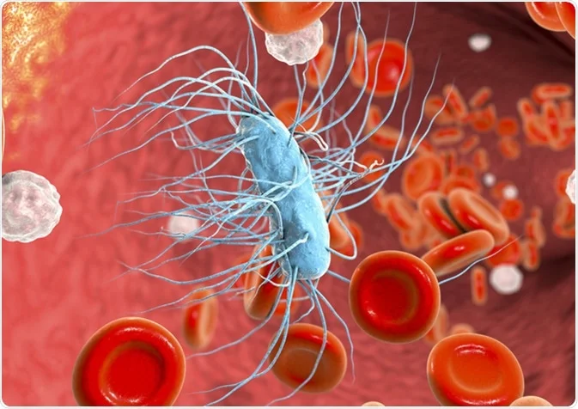
INTRODUCTION
Sepsis is a life-threatening condition caused by the body's response to infection.
Early recognition and timely intervention are crucial for improving patient outcomes.
Mortality prediction models can aid in identifying patients at high risk of death.

Slide 5
BACKGROUND AND MOTIVATION
It is a major global health concern with a high mortality rate, making early intervention critical. Identifying patients at high risk of sepsis mortality can help allocate resources and provide timely care.
Early mortality prediction can guide healthcare providers in prioritizing sepsis patients for immediate treatment. Reducing sepsis-related mortality is a healthcare priority, as it remains a leading cause of death worldwide.
Machine learning and predictive analytics offer a data-driven approach to identify at-risk patients based on objective criteria.
Developing accurate mortality prediction models can enhance sepsis management and ultimately save lives.

Slide 6
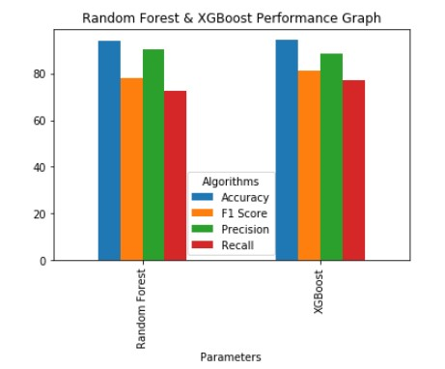
METHDOLOGY
The Algorithms used in our project are:
Random Forest :A random forest is an ensemble machine learning algorithm that combines multiple decision trees to make more accurate predictions by reducing overfitting and increasing generalization.
XG Boost : XG Boost is a gradient boosting machine learning algorithm known for its exceptional predictive performance and speed, particularly suited for regression and classification tasks.

Slide 7
EXISTING SYSTEM
Sepsis is a very dangerous and serious condition caused by an infection that leads to tissue damage and organ failure due to an increase of chemicals in the bloodstream. It is crucial to provide fast and efficient treatment for the patient. Currently in clinical practice there are used different scoring systems to diagnose sepsis and the most important score system today is the sequential organ failure assessment score also abbreviated to SOFA(Sequential Organ Failure Assessment) score. It is based on various physiological and laboratory measures which are taken from blood samples and by analyzing if they are within a normal range or not.

Slide 8
PROPOSED SYSTEM
The mechanism of feature selection is used to filter out the most relatable features with the variable which are needed to predict. The model accuracy can be effected by using inappropriate features showing maximum outlier detection. This study has focused on six vital signs which are selected on the basis of statistical analysis by using Z test having the idea that these vital signs are present in all ICU patients and can be used for sepsis prediction. The correlation analysis has been used to extract the features that were showing highly contribution as predicting variables. This study shows the contribution in the comparison of different machine learning models and find out the best model which can be deployed in hospitals. The model is trained on the features selected from dataset. For the prediction of sepsis, every model has presented best performance by giving ROC curve from (0.95 to 0.98). There is no limitation in distribution of features while using these models therefore, they can used to tackle the large data as well. The evaluation of predictive model occur by confusion matrix which compute the sensitivity, error rate, precision and specificity while AUC is metric which differentiate the sepsis patients from other patients.

Slide 9
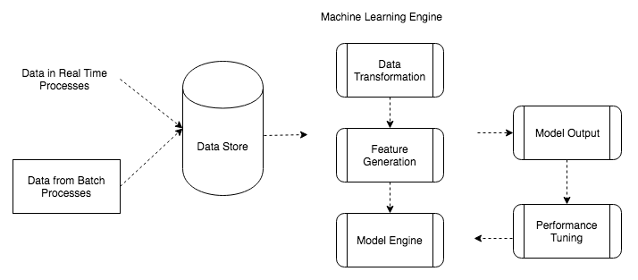

Slide 10
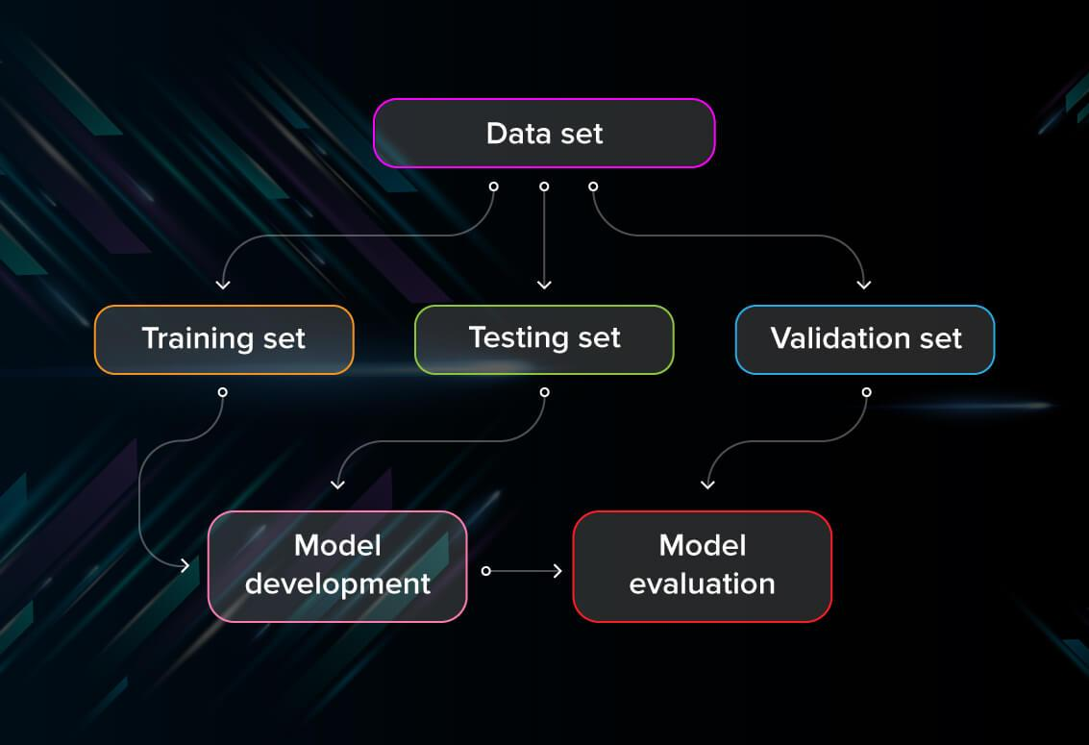

Slide 11
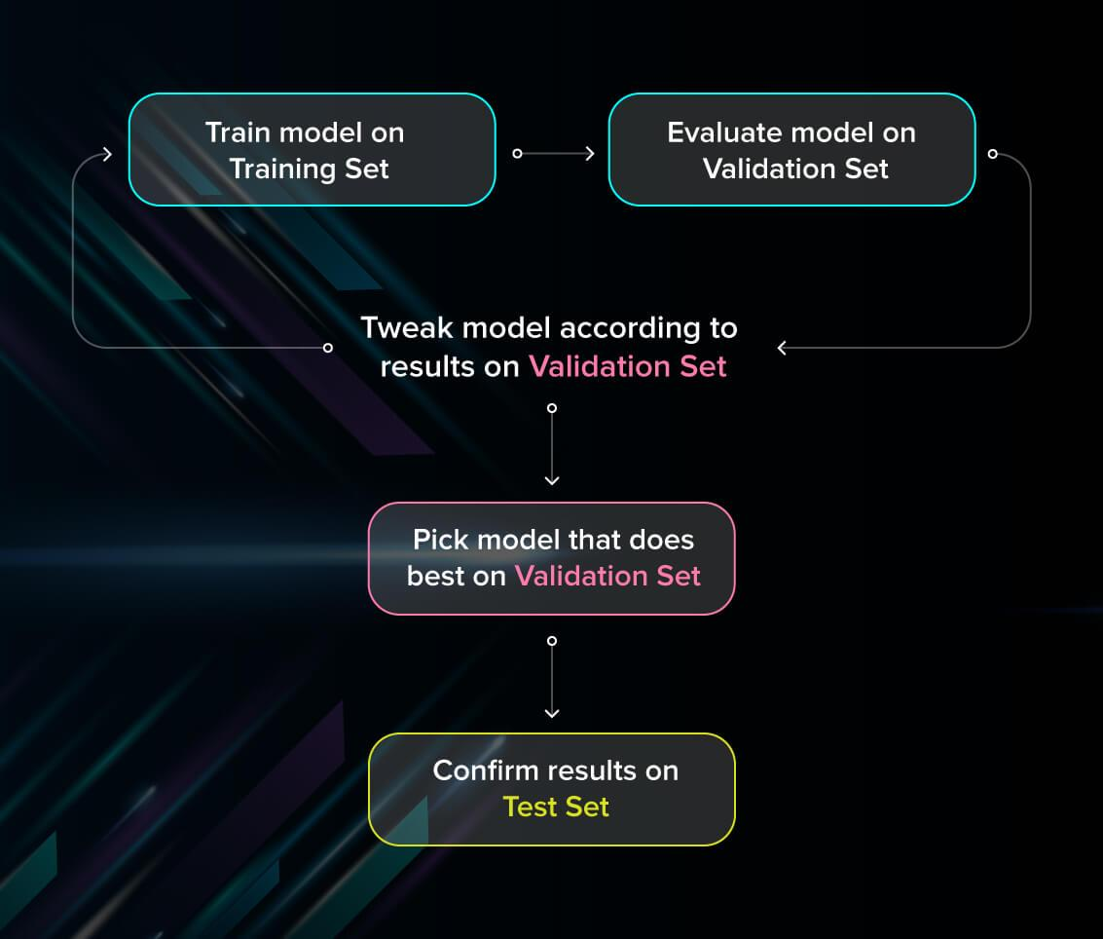

Slide 12
IMPLEMENTATION
Operating system : Windows / linux
Coding Language : Python /anaconda
Front-End : Python.

Slide 13
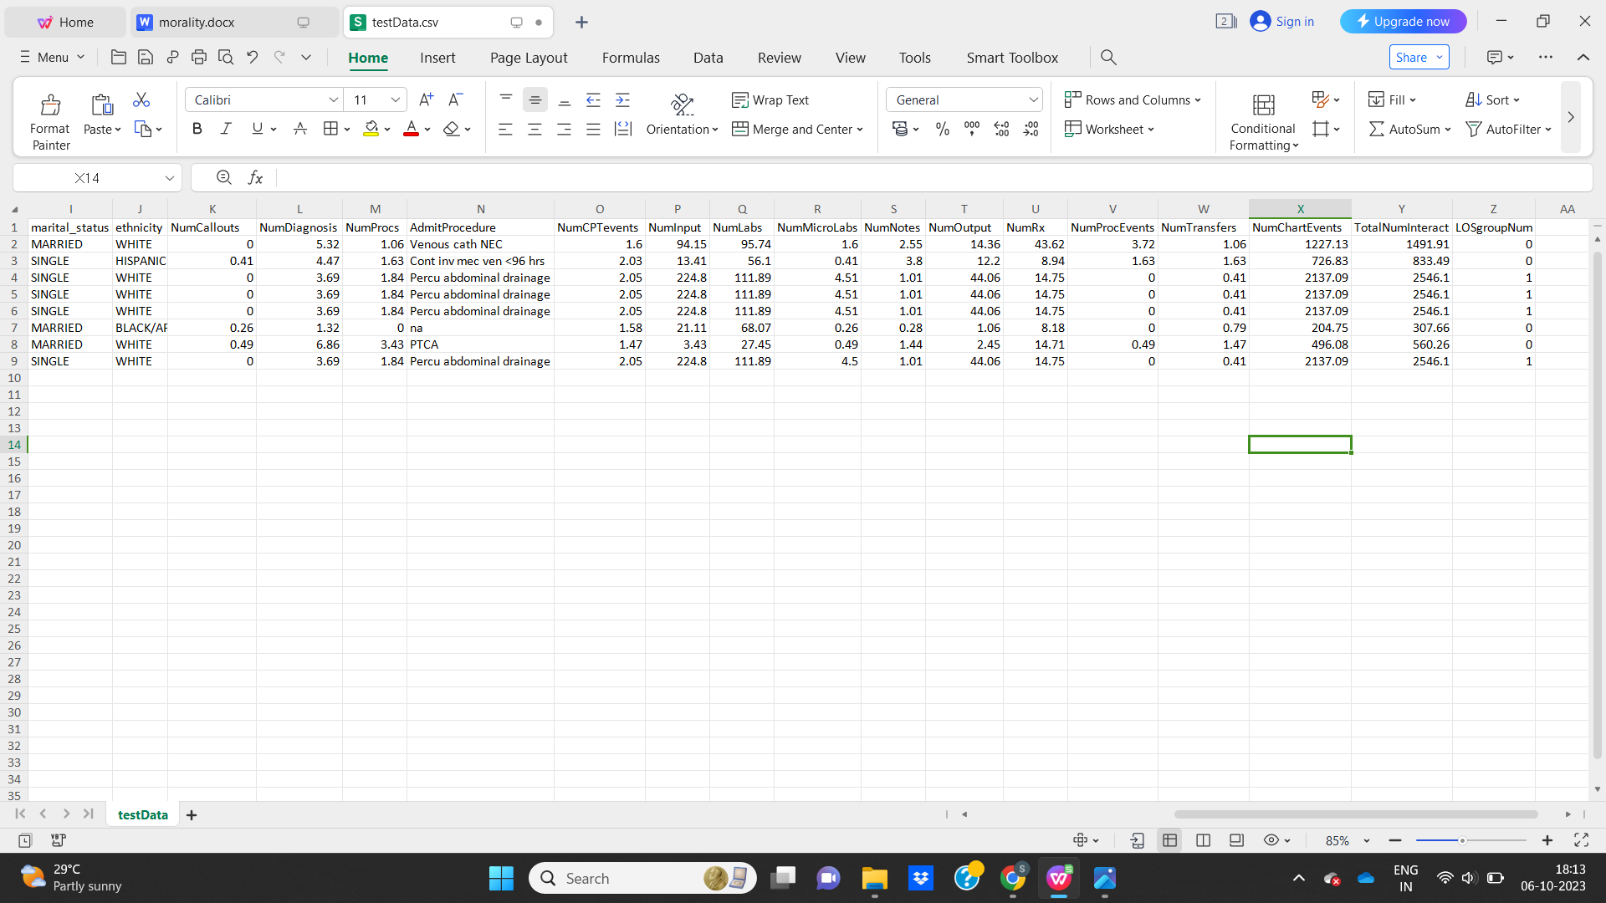
TEST CASES

Slide 14
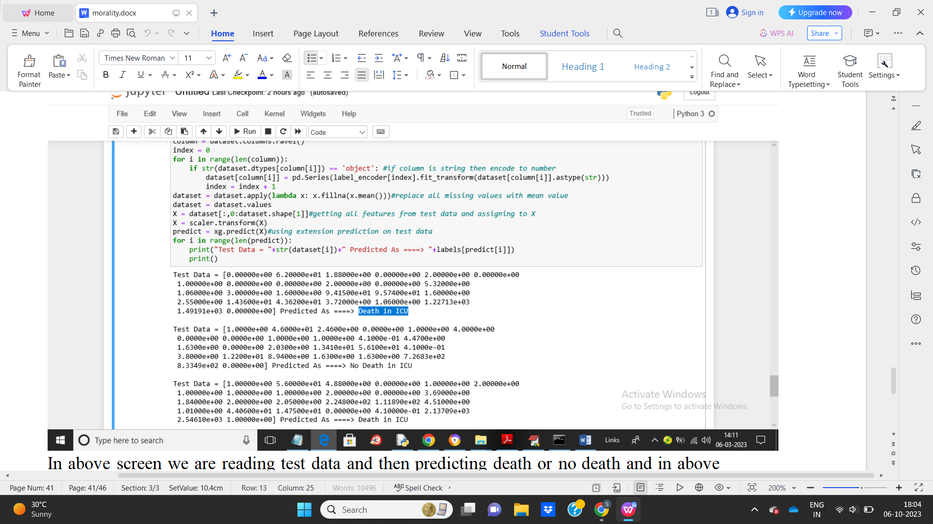
RESULT

Slide 15

CONCLUSION
Sepsis is life threatening disease which cause of high mortality rate and morbidity in hospitals. Early detection is a key to overcome the death rate, therefore this study showed the development of fast and accurate machine learning algorithm for the prediction of sepsis which gives the better results than the existing scoring systems. In addition, the comparative analysis has done between five main models of machine learning by measuring their specificity and sensitivity. These models has potential to use for commercial use in ICU’s for sepsis prediction.

Slide 16
REFERENCES
1 K. E. Rudd, S. C. Johnson, K. M. Agesa et al., “Global, regional, and national sepsis incidence and mortality, 1990–2017: analysis for the global burden of disease study,” The Lancet, vol. 395, no. 10219, pp. 200–211, 2020.
View at: Publisher Site | Google Scholar
2 L. Su, Z. Xu, F. Chang et al., “Early prediction of mortality, severity, and length of stay in the intensive care unit of sepsis patients based on sepsis 3.0 by machine learning models,” Frontiers in Medicine, vol. 8, 883 pages, 2021.
View at: Publisher Site | Google Scholar
3 K. C. Yuan, L. W. Tsai, K. H. Lee et al., “The development an artificial intelligence algorithm for early sepsis diagnosis in the intensive care unit,” International Journal of Medical Informatics, vol. 141, Article ID 104176, 2020.
View at: Publisher Site | Google Scholar
4 J. E. García-Gallo, N. J. Fonseca-Ruiz, L. A. Celi, and J. F. Duitama-Muñoz, “A machine learning-based model for 1 year mortality prediction in patients admitted to an intensive care unit with a diagnosis of sepsis,” Medicina Intensiva, vol. 44, no. 3, pp. 160–170, 2020.
View at: Publisher Site | Google Scholar

Slide 17
THANK YOU

